Slide 1
Vision Assist

Slide 2
Neural Nexus
IBM Mentor
Mr. Atul Pandey
Edunet Mentor
Mr. Adwaith R.S
Akash . T
Archana G.S
Muhammed Hidash
Sahal Muhammed K.K
Student Name

Slide 3
Workload Division
Contribution of each team member in project
Akash . T : Currency recognition, Object identification, Backend.
Archana G.S : Activity recognition, Voice feedback, Spatial description.
Muhammed Hidash : Text reading, Facial recognition, Spatial recognition.
Sahal Muhammed K.K : Frontend.

Slide 4
The Background
Historic Background
285M people worldwide live with visual impairment (WHO)
Traditional assistive technologies: canes, guide dogs, Braille displays, screen readers
Recent advancements: AI-powered solutions, GPS navigation, mobile accessibility
Current Scenario
Visually impaired individuals face challenges in daily tasks
Existing solutions: outdated, limited functionality, lack real-time feedback
Opportunity: leverage AI, computer vision, NLP for effective assistive tech
Introducing Vision Assist
AI-powered mobile app enhancing independence, safety, quality of life
Real-time assistance through object detection, facial recognition, voice feedback & more

Slide 5
Problem Statement
Visually impaired individuals face significant challenges in navigating their environment, identifying objects, recognizing faces, and performing everyday tasks.
Traditional aids like canes and guide dogs have limitations and do not fully address these challenges.
There is a need for a comprehensive, user-friendly, and accessible solution that integrates multiple functionalities to assist visually impaired individuals.

Slide 6
Proposed Solution
Vision Assist is an AI-powered mobile application designed to enhance the independence and safety of visually impaired individuals. Real-Time Currency Recognition: Detects and identifies different denominations of currency.
The app leverages advanced technologies such as object detection, Spatial Description, Activity Recognition, Voice Feedback Interaction, Text Reading, Real-Time Currency Recognition facial recognition, natural language processing and computer vision to provide real-time assistance in various aspects of daily life.

Slide 7
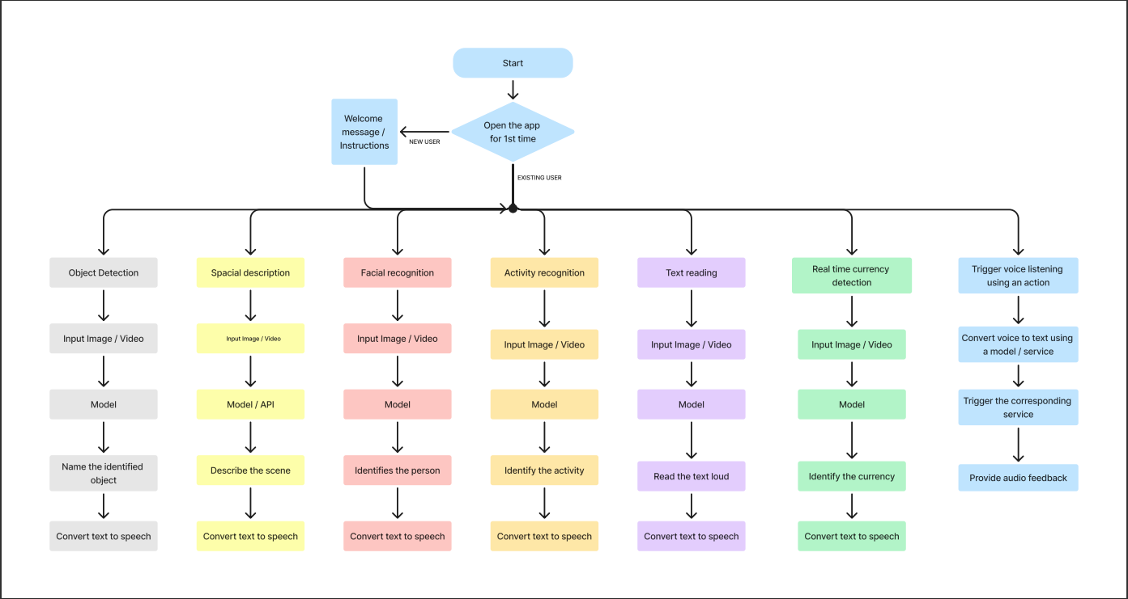
Solution Design

Slide 8
Technology Stack & Requirements
Technology Stack
Front-end: Flutter
Back-end: Django (Python-based)
AI Models: YOLOv5 (object detection), OpenAI Whisper (speech recognition), Custom AI models for face and currency recognition
API Integration: RESTful API, OpenAI Whisper API
Hardware
Smartphone with camera and microphone
Minimum of 4 GB RAM
Internet connectivity for API requests
Software
Operating System: Android or iOS
Development Tools: Flutter, Android Studio, XCode
Python Libraries: TensorFlow, OpenCV, Pytesseract, Django, Torch
Deployment Environment
Server for API deployment: AWS, Heroku, or local Django server.
Mobile App Deployment: Google Play Store or Apple App Store.
Locally: For demonstration

Slide 9

Innovative Idea
Voice Feedback: Integrated TTS for real-time voice feedback after each action.
Real-Time Object and Activity Recognition: Utilizes YOLOv5 for objects and MoViNet for activity recognition on-device.
Personalized Face Recognition: Allows users to add and recognize faces via voice or manual input.
Indian Currency Recognition: Custom MobileNetV2 model trained for real-time recognition of Indian currency.

Slide 10
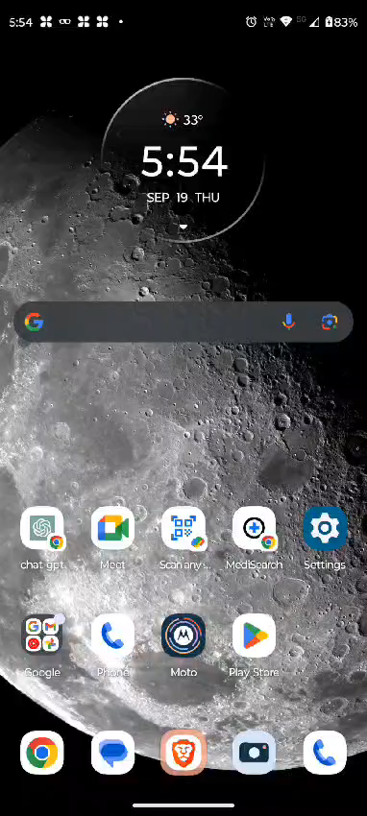
Results / Outcomes / Analysis

Slide 11
Results / Outcomes / Analysis
Analysis:
The combination of voice interaction, real-time object detection, image description, text reading, currency detection and activity recognition proved to be a powerful tool for visually impaired users.

Slide 12

Limitations
Limitations:
Dependence on Internet Connectivity.
Limited Compatibility.
Accuracy Issues in Low-Light.
Limited Object Recognition.
Steep Learning Curve.
Technical:
Battery Drain.
AI Model Training Data.
Integration Limitations

Slide 13

Future Enhancements/Scope
Navigation Assistance: Integrate turn-by-turn navigation with obstacle avoidance to guide users safely.
Indoor Navigation: Use Bluetooth beacons or Wi-Fi positioning for accurate navigation in indoor environments like malls and airports.
Expanded Language Support: Provide support for multiple languages for voice feedback to cater to a global audience.
Crowdsourced Hazard Reporting: Enable users to report and share hazards, creating a community-driven safety database.
Enhanced Depth Estimation: Incorporate dual-camera smartphones or external sensors for more accurate depth estimation and obstacle detection.

Slide 14
The Demo showcasing the working solution/prototype https://github.com/akzgit/vision_assist.git

Slide 15
Thank You

